Slide 1
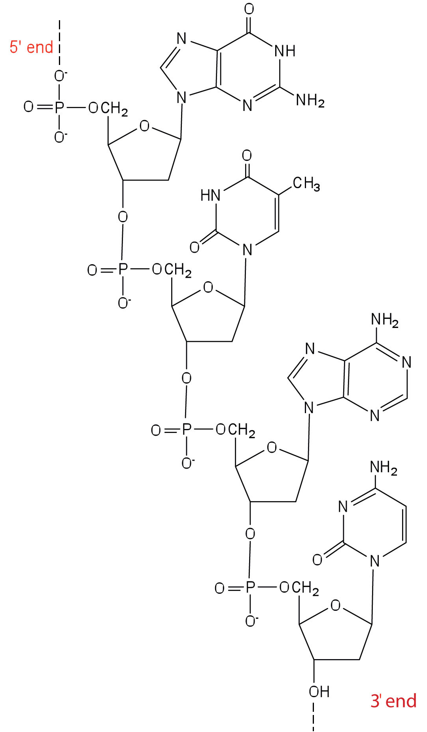
Nucleotides

Slide 2
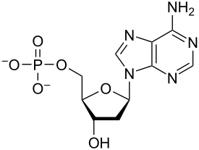
Base
Phosphate Group
Pentose Sugar

Slide 3
